Slide 1
The Restaurant Battle
of Manhattan Neighborhoods

Slide 2
INTRODUCTION
A pair of restaurant owners want to expand operations to high density locations that are most ideal location to open up a chain of profitable restaurants.
Their growth strategy is to be able to open sustainable franchises domestically in the northeast region of the United States and then other major cities across the nation in the future.
The owners want to target Manhattan in New York City first.
By exploring each neighborhood, their venues, and analyzing trends, the owners will be able to effectively gauge optimal locations that will yield the best possible success, sustainability, and growth for their restaurant expansion.

Slide 3
DATA ACQUISITION AND CLEANING
Dataset 1: New York City borough, neighborhood, latitude, and longitude data https://cocl.us/new_york_dataset
Dataset 2: Manhattan neighborhood, venue, venue latitude, venue longitude, venue category. Accessed via Foursquare API - https://api.foursquare.com/v2/venues/explore?
Final dataset includes Borough, Neighborhood, Latitude, and Longitude
306 neighborhoods among the 5 New York City boroughs (Brooklyn, Bronx, Manhattan, Staten Island, and Queens)
40 neighborhoods in the Manhattan borough
342 different venue categories in the Manhattan borough

Slide 4

METHODOLOGY & ANALYSIS
The K-Means clustering algorithm was used to form clusters of the Manhattan neighborhoods and their venues data to further segment our analysis
5 clusters of neighborhoods were created to narrow down the neighborhoods and ultimately select one for additional synthesis.
Cluster 3 yielded the lowest Restaurant/Neighborhood ratio and was selected for optimal density distribution.

Slide 5
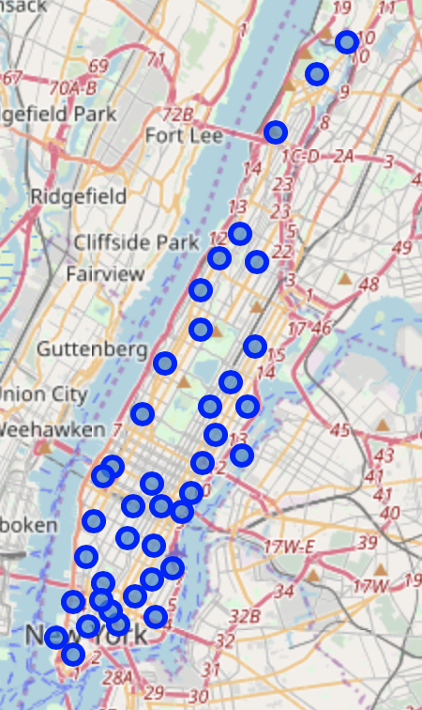
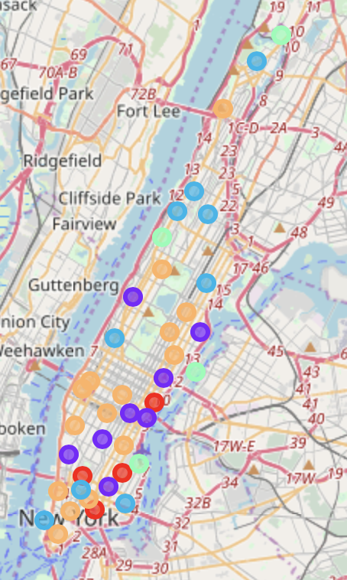
VISUALIZATION
All Manhattan neighborhoods
Manhattan neighborhoods segmented into 5 clusters

Slide 6
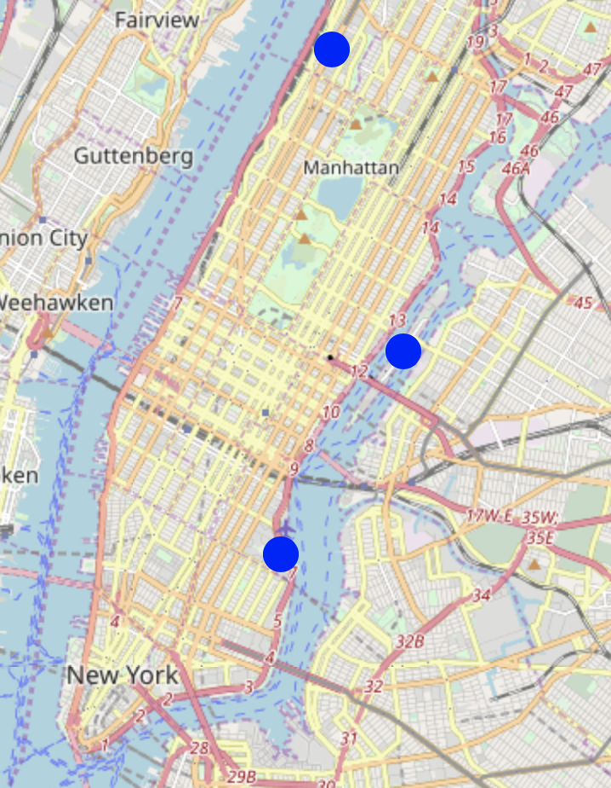
VISUALIZATION
Map displaying the 3 resulting Manhattan neighborhoods depicted by the blue dots:
Morningside Heights
Roosevelt Island
Stuyvesant Town

Slide 7
CONCLUSION
The purpose of this project was to identify neighborhoods in Manhattan, New York with a low number of restaurants in order to aid stakeholders in narrowing down the search for optimal location(s) for a new restaurant.
By analyzing restaurant density distribution from Foursquare data, we identified the five most common nearby venues of each neighborhood.
With the help of clustering techniques and further analysis, we were able to narrow down to three neighborhoods - Morningside Heights, Roosevelt Island, and Stuyvesant Town - that fit the density criteria yielding ideal candidate locations for opening up a new restaurant.

Slide 8
Thank You

